Slide 1
2005-06 National Family Health Survey (NFHS-3)
Nutrition in India
Dissemination Seminar on
Subject Reports Findings

Slide 3
Topics
Children’s nutrition
Nutritional status
Anaemia
Child feeding practices
Micronutrients
ICDS food supplementation

Slide 4
Topics
Adult nutrition
Nutritional status
Anaemia
Food consumption

Slide 5
Undernutrition in Children under Age 5
Percent

Slide 6
Children’s Nutrition
Stunting and underweight in India are 20 times as high as would be expected in a healthy, well-nourished population

Slide 7
Undernutrition in Children under Age 5
INDIA
Percent

Slide 8
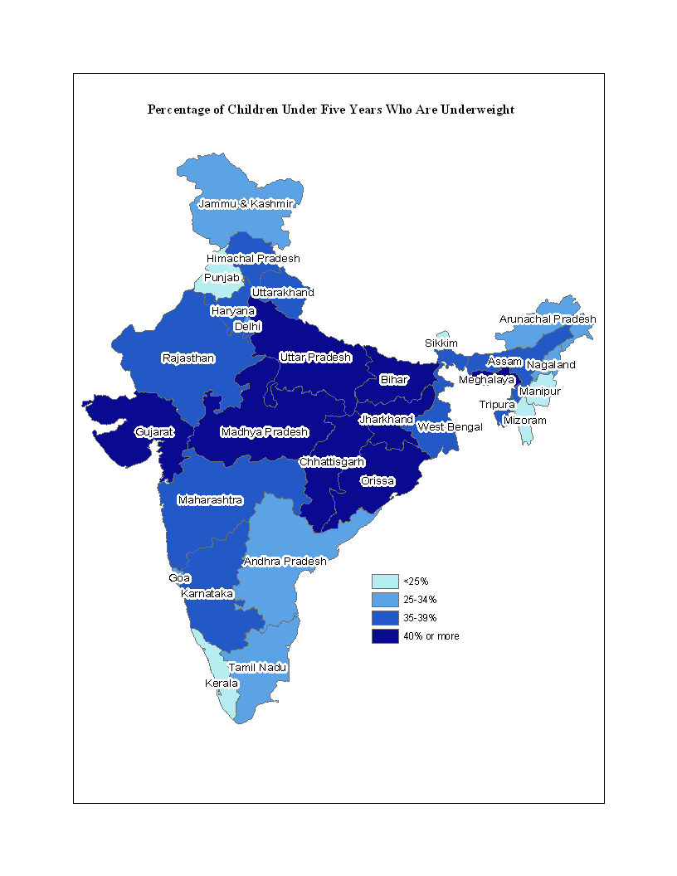
Undernutrition in Children under Age 5
INDIA
Percent

Slide 9
Trends in Undernutrition
(children under age 3)
Percent

Slide 10
Underweight by Wealth Quintiles
Percent

Slide 11
Undernutrition in Children under Age 5
INDIA
Poor nutrition contributes to 54% of deaths under age 5
Percent

Slide 12
Recommended and Actual Breastfeeding Practices
Goal: Initiation of breastfeeding within 1 hour of birth
Achievement: 25%
Goal: No prelacteal feeding
Achievement: 43%
Goal: Exclusive breastfeeding
(6 months)
Achievement: 46%

Slide 13
Recommended and Actual Breastfeeding Practices (contd.)
Goal: Timely complementary feeding (age 6-8 months)
Achievement: 53%
Goal: Feed breast milk or milk products, and feed a minimum number of times from a minimum number of food groups (age 6-23 months)
Achievement: 21%
These are recommended IYCF feeding practices

Slide 14
Micronutrient Intake
Goal: Vitamin A supplements every 6 months from 9 months to 3 years
Achievement: 25%
Goal: Universal salt iodization
Achievement: 47% of children live in households using adequately iodized salt

Slide 15
Anaemia among Children Age 6-35 Months
Percent

Slide 16
ICDS Utilization
72% of NFHS-3 enumeration areas were covered by an anganwadi centre (AWC)
Although ICDS coverage is fairly high, only 28% of children under age 6 years received any service from an AWC in the last year

Slide 17
How Many Children Receive Services from an AWC?
Percent of age-eligible children in areas with an AWC

Slide 18
Adult Nutrition
The poor nutrition conditions of young children in India have received much attention recently, but adults are also experiencing a variety of nutritional problems

Slide 19
Percentage of Adults Age 15-49 Malnourished
In the highest wealth
quintile, 31% of women
are overweight, including
8% who are obese

Slide 20
Percentage of Women
Overweight or Obese
Women age 15-49
Even in the slums, 19-39% of
women are overweight/obese

Slide 21
Undernutrition in Children under Age 5
INDIA
Percent

Slide 22
Dual Burden of Malnutrition
Percent of women age 15-49

Slide 23
Anaemia in Women and Men

Slide 24
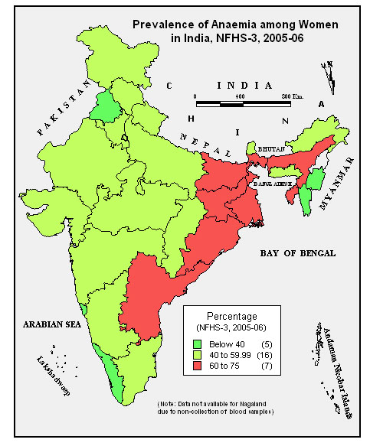

Slide 25
Consumption of Meat, Chicken or Fish
Percent of women and men age 15-49

Slide 26
Undernutrition in Children under Age 5
INDIA
Percent

Slide 27
Conclusions
Children in India suffer from some of the highest levels of stunting, wasting and underweight in the world, and the situation has not improved markedly in recent years.
Anaemia levels among children are very high and they have actually increased since the time of NFHS-2.
Most recommended infant and young child feeding practices are widely ignored by parents.
The ICDS programme, which has been in operation for more than 30 years, has not been able to reduce malnutrition to acceptable levels in any state.

Slide 28
Conclusion
The adult population suffers from a dual burden of undernutrition and overweight/ obesity
Almost half of women and more than 40% of men in most population subgroups are either too thin or too fat

Slide 29
Policy and Program Messages
Disadvantaged groups have more serious nutrition problems than other groups, so targeted nutrition programmes are needed to improve their conditions.
Poverty is strongly related to malnutrition, but poverty reduction programmes alone will not eliminate nutritional deficiencies.
Nutritional problems are widespread even among
the best educated and wealthiest groups, so programmes cannot ignore these groups.

Slide 30
Policy and Program Messages
Poor feeding practices for children have made it difficult to make solid improvements in the nutritional status of children, so education on proper infant and child feeding is vital.
Although overweight and obesity are much less of a problem in India than in more developed countries, this is a growing problem among adults, particularly in the cities. Programmes to prevent the spread of overweight and obesity need to be strengthened.
The coverage of the ICDS programme is quite good in most places, but improvements in the quality of ICDS services are needed to increase utilization.

Slide 31
Final Word
There is no longer any doubt that nutritional problems in India need to be urgently addressed. The good news is that health officials now seem energized to take on the challenge and to implement innovative programmes to get results.
We all hope that NFHS-4 and other data collection efforts in the coming years will be able to document the fruits of these efforts.

Slide 32
Thank You

